Slide 1

Introduction
Overview
User Persona
User Journey Map
User Experience Insights
Key Metrics
NETFLIX
New User Onboarding
Product Teardown
Mayank Kumar

Slide 2






Introduction
Overview
User Persona
User Journey Map
User Experience Insights
Key Metrics
It is an American subscription streaming service founded back in 1997, based in Los Gatos, California.
It is a streaming giant with over 220 million paid subscribers worldwide (2022) with a revenue of $ 30 billion (2021)
Its presence is currently in 190+ countries, with over 15,000 content titles
available in 30+ languages!
Its main competitors include:
“At Netflix, we want to entertain the world. Whatever your taste, and no matter where you live,
we give you access to best-in- class TV shows, movies, and
documentaries.”
Value Propositions:
To provide quality entertainment to the user 24x7.
Did you know?
On average, Netflix subscribers spend 3+ hours per day consuming content?
Access to a vast and diverse library of content.
On demand, 24 x 7, no-ad service.
Possibility of binge watching.
Personalised list and recommendations based on content watches.
Original and high definition content.
User accounts allowing personalised
experience for each family member.
Access to any device with internet

Slide 3


Introduction
Overview
User Persona
User Journey Map
User Experience Insights
Key Metrics
Matthew Perry
20, College Student Pasadena, California Lives on Campus at Caltech
Courteney Cox
26, Business Analyst
SF, California
Lives in an Apartment with roommate
Behaviour:
Studies and goes to classes in day.
Binges content at night. Low disposable income.
Pain Points:
Finding the next show to watch easily.
Good UI to supporting binging – progress track, next episode, episode list.
Needs a place where he can share account with family to optimise budget; but also keep it personalised.
Needs a cross platform support so he can continue watching during class breaks.
Behaviour:
Watches 2-3 episodes to unwind on a
weekday night & 8-9 hrs on weekends.
Considerable entertainment budget.
Pain Points:
Deciding what to watch – needs a place to keep track of recommendations by friends and family & to get good recommendations.
Find something to watch easily - Needs to minimise time wasted on deciding what to watch.
Needs 4k content to watch on TV.
Needs progress tracking of episodes.

Slide 4
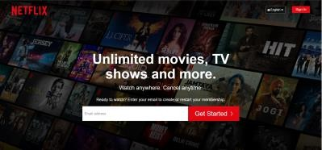
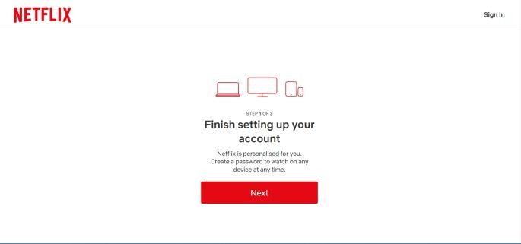
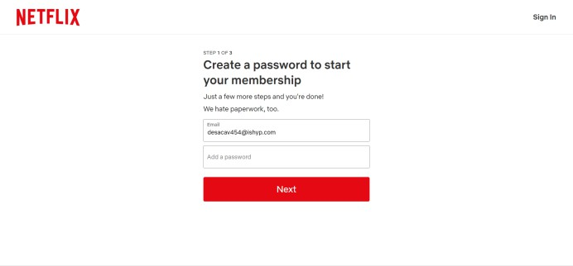
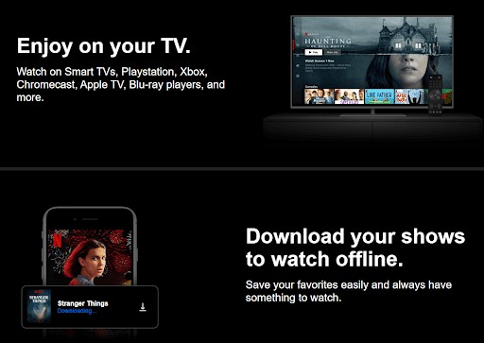
Introduction
Overview
User Persona
User Journey Map
User Experience Insights
Key Metrics
Discovery
Email & Password
Setting up
Doing
The UI looks cool! This could be
what I needed. Unlimited?
Amazing! It has so many perks and is available in my local lang!
It’s personalised and is multi platform compatible? Wow that’s great!
Password? Hope this isn’t a long process. Also, I hope I don’t forget my password
Thinking
🤩
☺️
😐
Feeling
Most sites these days allow other signup options. Google / phone no. / FB
If there was other sign up options, this password step would be easier through OTP / Third party authentication through Google / Facebook
Pain Points

Slide 5
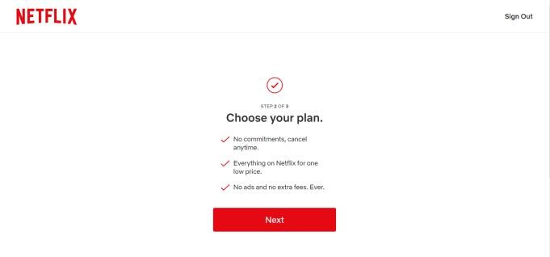
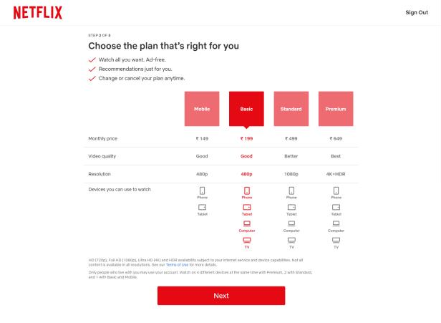
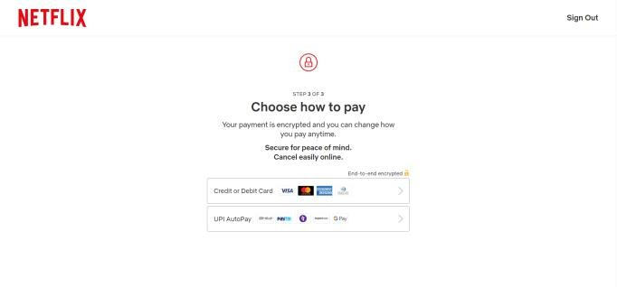
Introduction
Overview
User Persona
User Journey Map
User Experience Insights
Key Metrics
Payment Options
Choose plan
Choose Plan
Doing
Cancel anytime? That’s good! No ads at all? That would be convenient
Wow these plans are pricey as compared to other platforms. Hope it is worth it.
Even if they say the transaction is safe, why are they saving the card info? Is this safe?
Thinking
☺️
😓
😥
Feeling
No economical pricing; no option of trial plan anymore to make customer understand the price point; no plan which allows a few ads at a discount rate
Should also have an assurance that the payment info is safely saved for month on month auto payment.
Pain Points

Slide 6
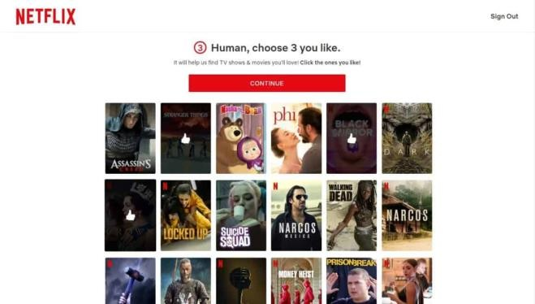
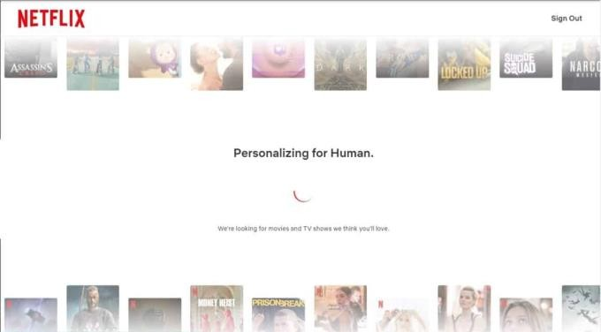
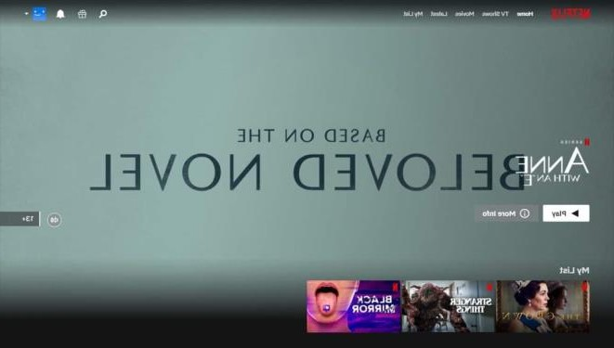
Introduction
Overview
User Persona
User Journey Map
User Experience Insights
Key Metrics
Choose Content
Preparing
Done!
Doing
Will it really be a great recommendation experience? What to choose?
Really hope the
recommendation engine is as good as they say, it was pretty pricey after all
Wow the recommendations are good, amazing and intuitive UI.
Very diverse high quality
content! I am glad I chose this!
Thinking
🤔
😣
🤩
Feeling
Should have different 3 choices for TV shows and Movies
Pain Points

Slide 7
Introduction
Overview
User Persona
User Journey Map
User Experience Insights
Key Metrics
The Pros
The Cons
Diverse content, relatable region specific content. Genres, Language, Netflix exclusive content, Quality, Intuitive UI etc are best in class!
Netflix offers a very good organisation of its content and personalisation.
The recommendation engine lives up to its name
Short on-boarding process from any device, no requirement of accessing any other device for 2 factor authentication
Learning curve to use the product is non- existent.
Cannot watch a few international content.
Should have the option to “Browse by Region”.
No organisation in the “My List” feature. It just appears in chronological order in which I added content.
Should include few important features like character x-ray, day’s view duration
No social aspect to interface, cannot share with
friends, rate, review, watch party etc.

Slide 8
Introduction
Overview
User Persona
User Journey Map
User Experience Insights
Key Metrics
UI Elements that Stood Out
UI & Navigation is really user friendly improving the overall experience!
On keeping the cursor on the title, a preview is played, which helps user to judge if he wants to watch it now or later
On clicking ‘episodes & info’ button, we can see a little window with the details, not navigating to another window or simply start playing the title. This helps the user to conveniently browse through content summaries and details without feeling overwhelmed by repeated window navigation.
When clicking the next button while browsing through a row of titles, a small
progress bar is displayed at the top, helping me judge the amount of titles present and accurately know when they are repeated from beginning.

Slide 9
Introduction
Overview
User Persona
User Journey Map
User Experience Insights
Key Metrics
North Star Metric: Netflix's North Star Metric is “User Watch Time”
L1 Metrics L2 Metrics
Unique – Measuring a unique log-in who watched some length of a piece of content
Acquisition:
#Qualifiedleads; #Signups;
Customer Acquisition cost = Total cost of sales & marketing / #users acquired
Retention Rate = (Remaining users) / (Initial no of users)
Time to Value
Lifetime Value = Avg sales value x # Trxn x Retention Period
Customer Lifetime Value = LTV x Profit Margin
No of onboarding support tickets over a span of time
Awareness
#Website visits
Time spent on website
Acquisition
#Downloads & #Installations
Activation
#Steps completed in onboarding process
Completion rate = #Users who finished onboarding process / #Users in that onboarding cohort
Engagement = #active users in cohort / #users in cohort – cohort based on when onboarding started
Revenue
Free Trial conversion rate = #users convert / #users in free trail

